Slide 1
P697-1: QC first pass
Thomas H. Edwards
20260106

Slide 2
Qc: results first with initial thresholding
pool | jointQC | n | pct
pool697-1_1 | ATAC only | 702 | 5.9
pool697-1_1 | Both pass | 10043 | 84
pool697-1_1 | GEX only | 1179 | 9.9
pool697-1_1 | Neither | 36 | 0.3
pool697-1_2 | ATAC only | 982 | 7.1
pool697-1_2 | Both pass | 11558 | 83.3
pool697-1_2 | GEX only | 1158 | 8.3
pool697-1_2 | Neither | 179 | 1.3
pool697-1_3 | ATAC only | 485 | 4.7
pool697-1_3 | Both pass | 8705 | 84.8
pool697-1_3 | GEX only | 1040 | 10.1
pool697-1_3 | Neither | 34 | 0.3
pool697-1_4 | ATAC only | 1345 | 7.9
pool697-1_4 | Both pass | 13406 | 78.9
pool697-1_4 | GEX only | 1881 | 11.1
pool697-1_4 | Neither | 353 | 2.1
jointQC | n | pct
ATAC only | 3514 | 6.6
Both pass | 43712 | 82.3
GEX only | 5258 | 9.9
Neither | 602 | 1.1

Slide 3
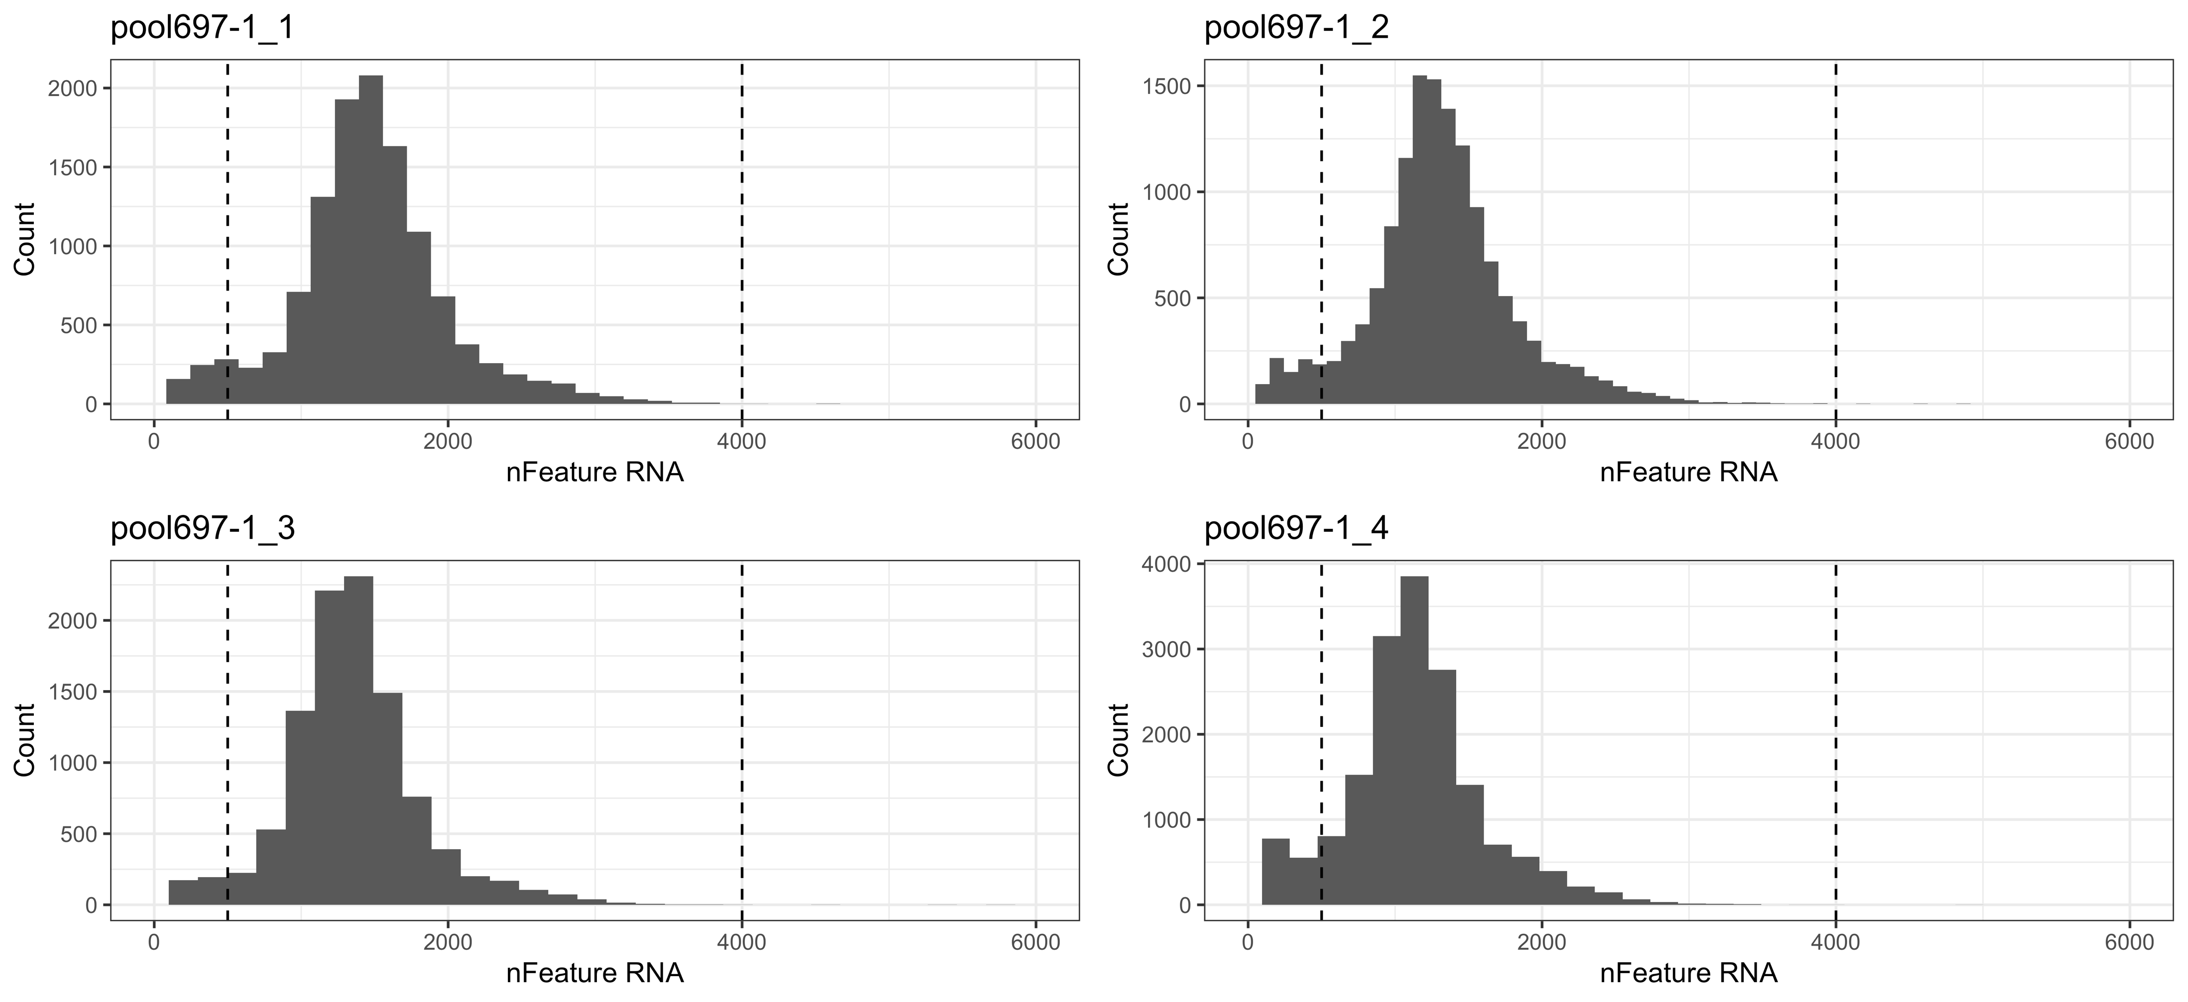
Nfeatures/cell
Quality is overall good with high pool-pool consistency

Slide 4
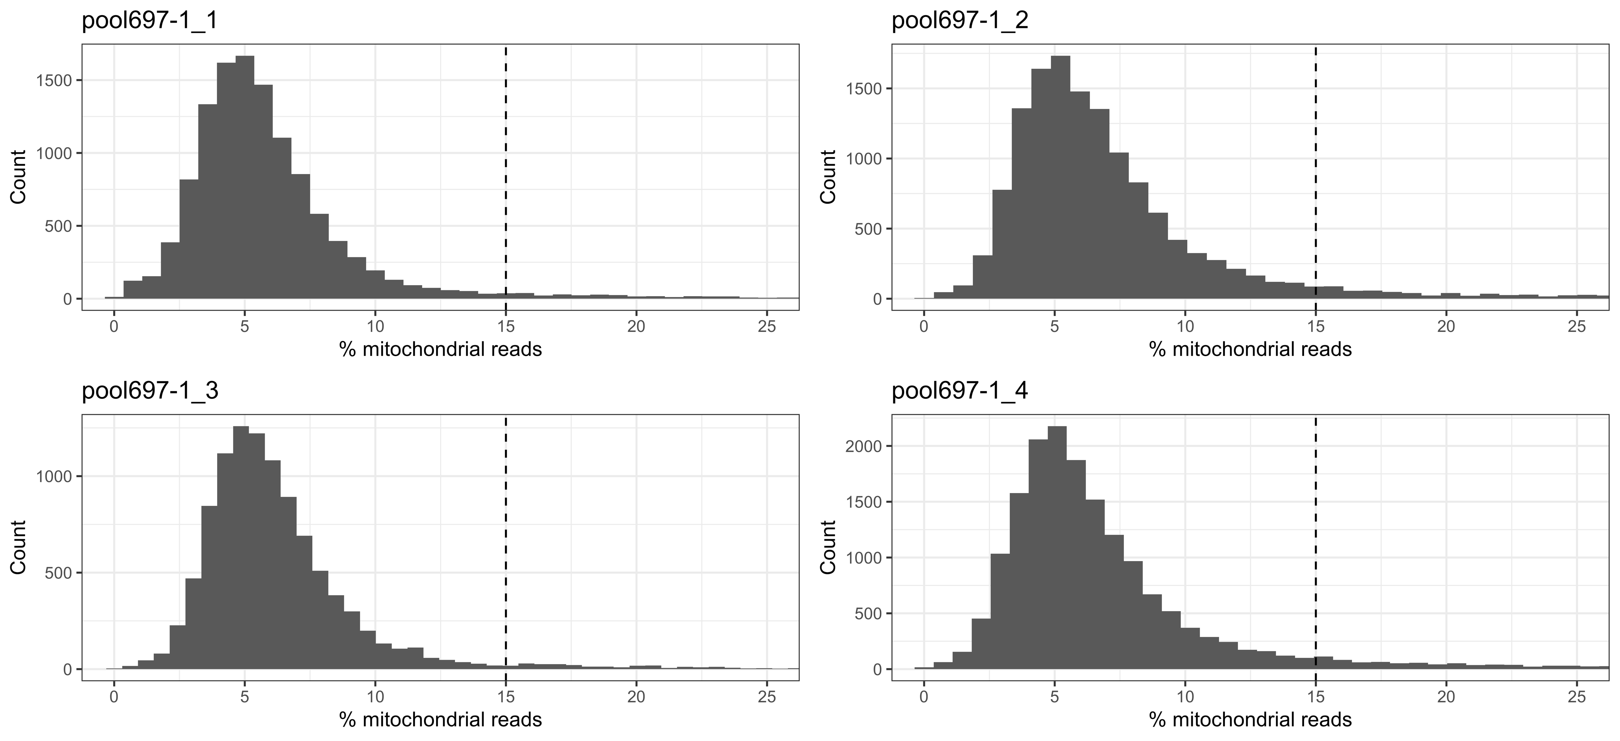
Percent mitochondrial reads
Quality is consistent with PBMCs

Slide 5
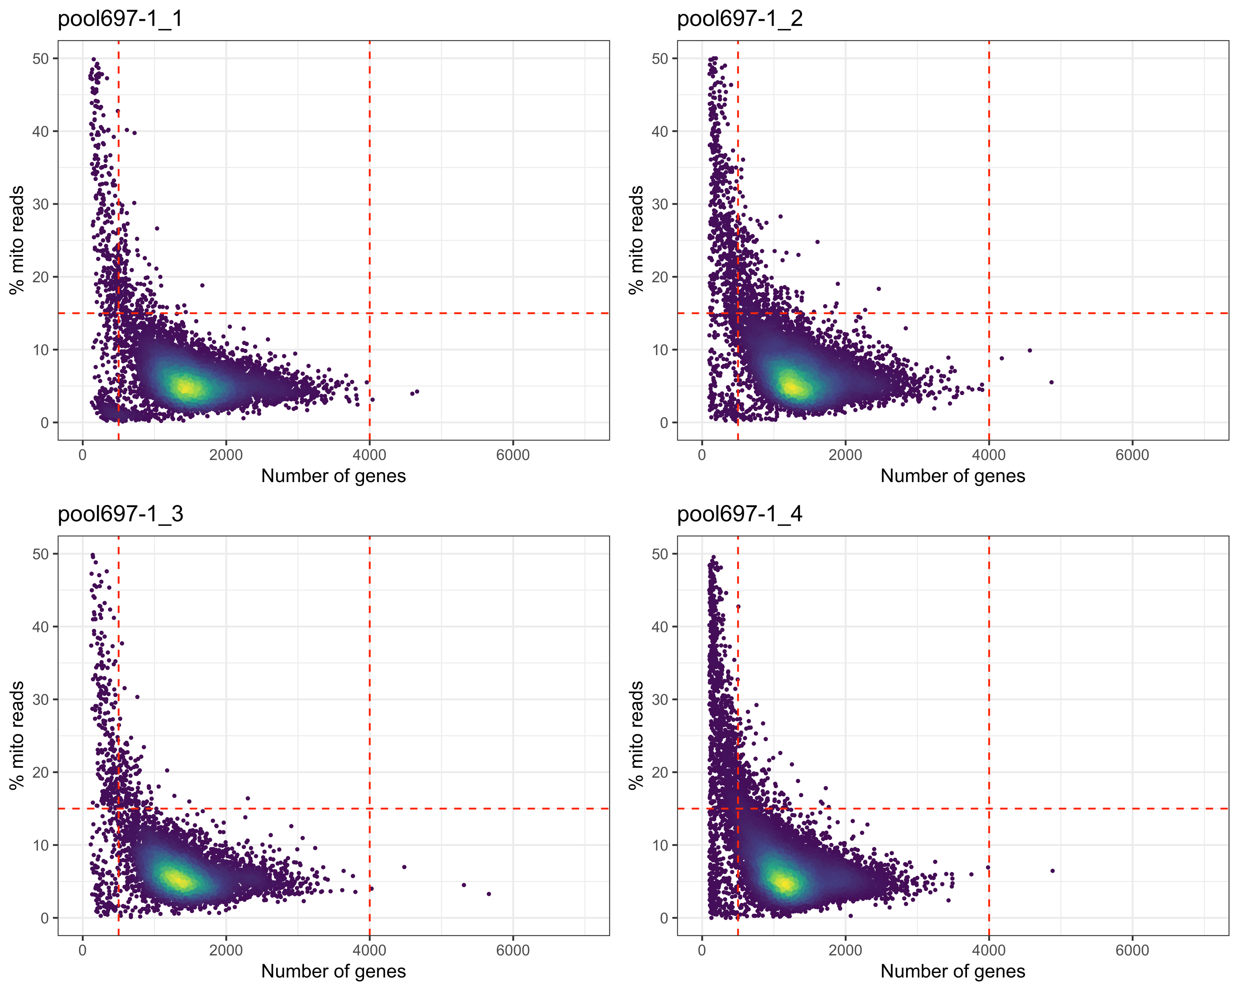
Combined nfeatures/%mito thresholding
Quality here looks good

Slide 6
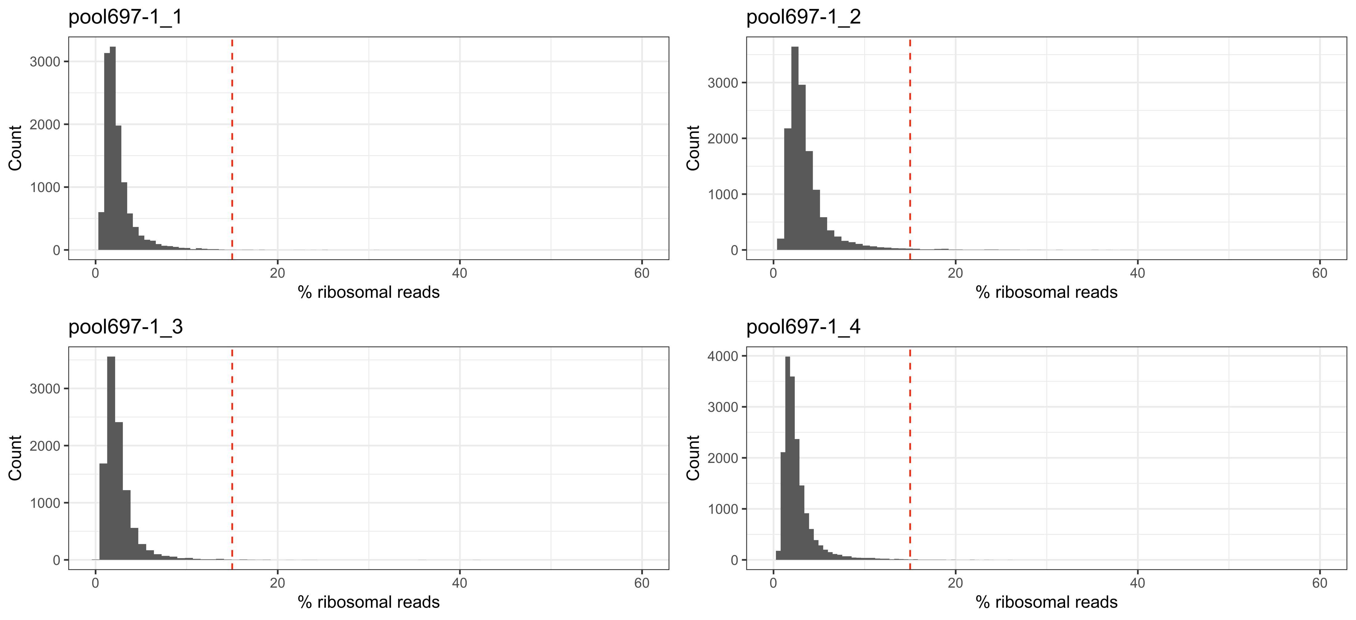
Percent ribosomal reads
Quality looks good and pools are consistent

Slide 7
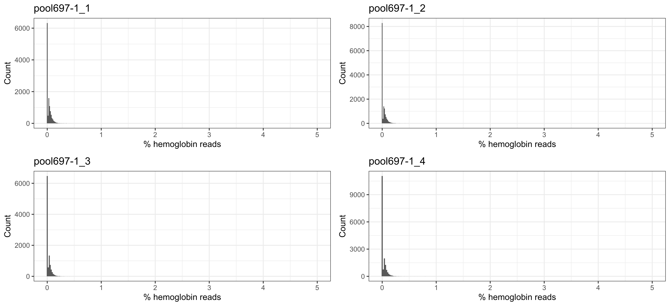
Percent hemoglobin reads
No worries here!

Slide 8
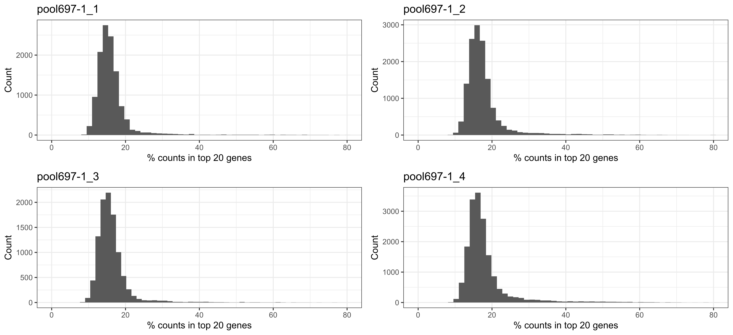
Percent of counts in top 20 most-expressed genes
Likely no worries about saturation from this metric

Slide 9
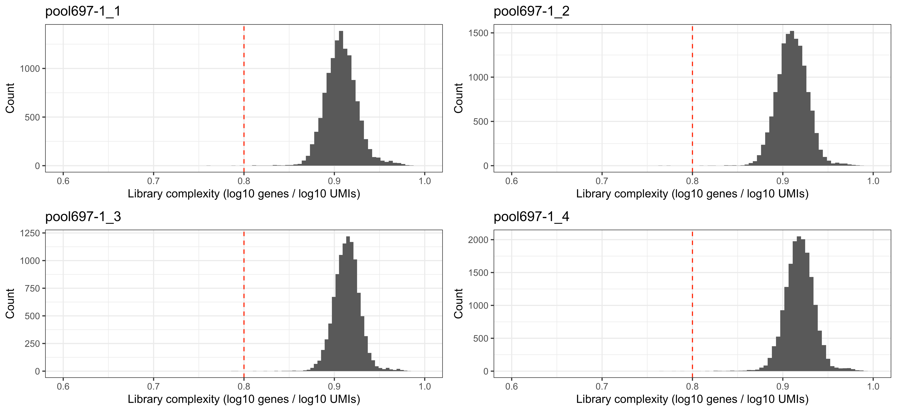
Complexity (ratio of genes to umis)
Again, we don’t appear to have a saturation issue

Slide 10
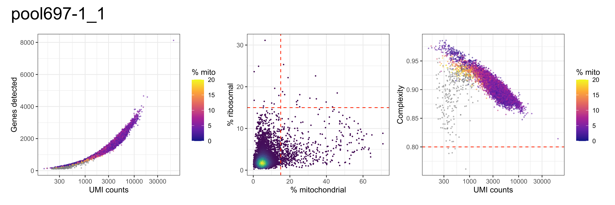
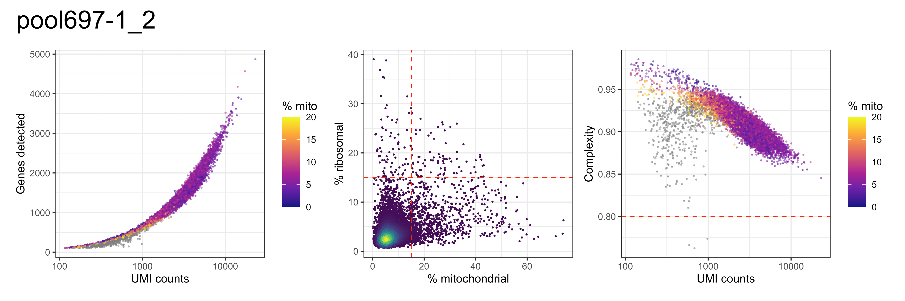
Qc correlation plots, pools 1 and 2

Slide 11
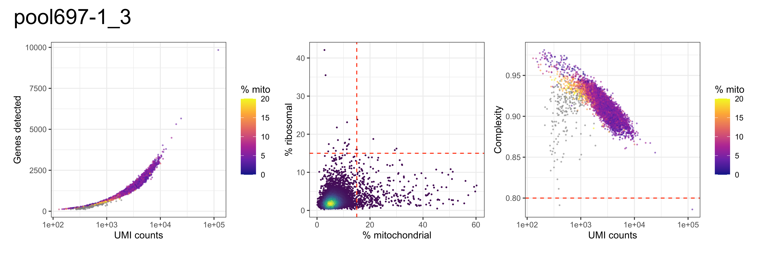
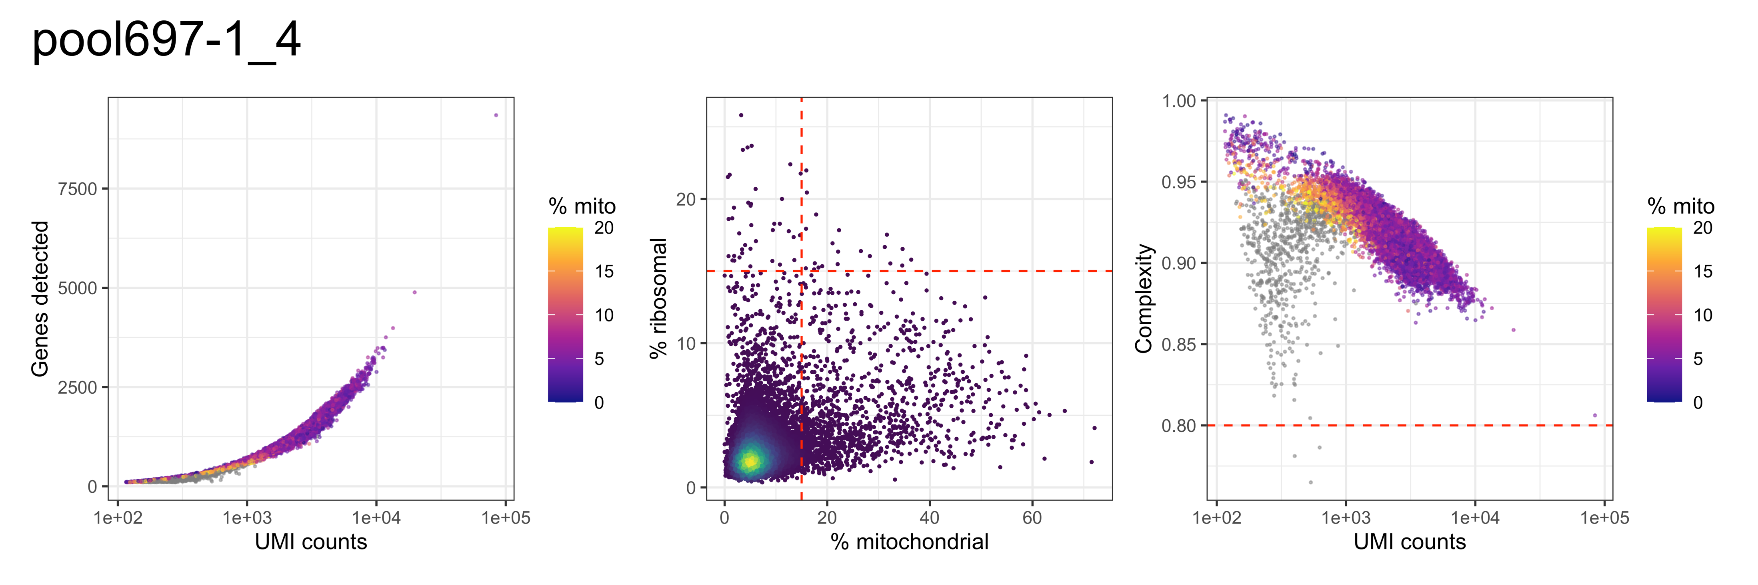
Qc correlation plots, pools 1 and 2

Slide 12
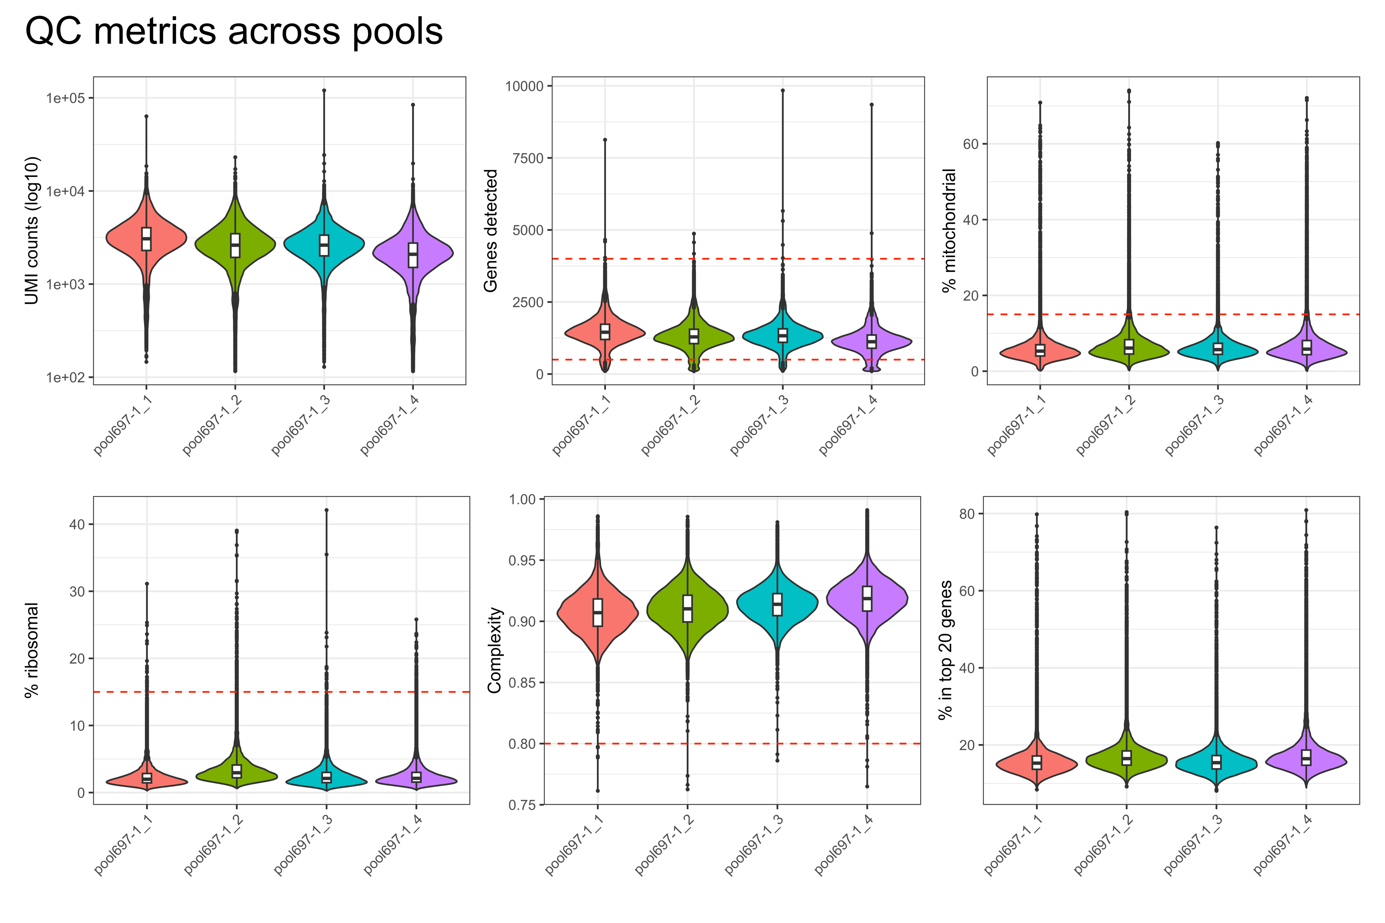
Qc metrics summarized

Slide 13
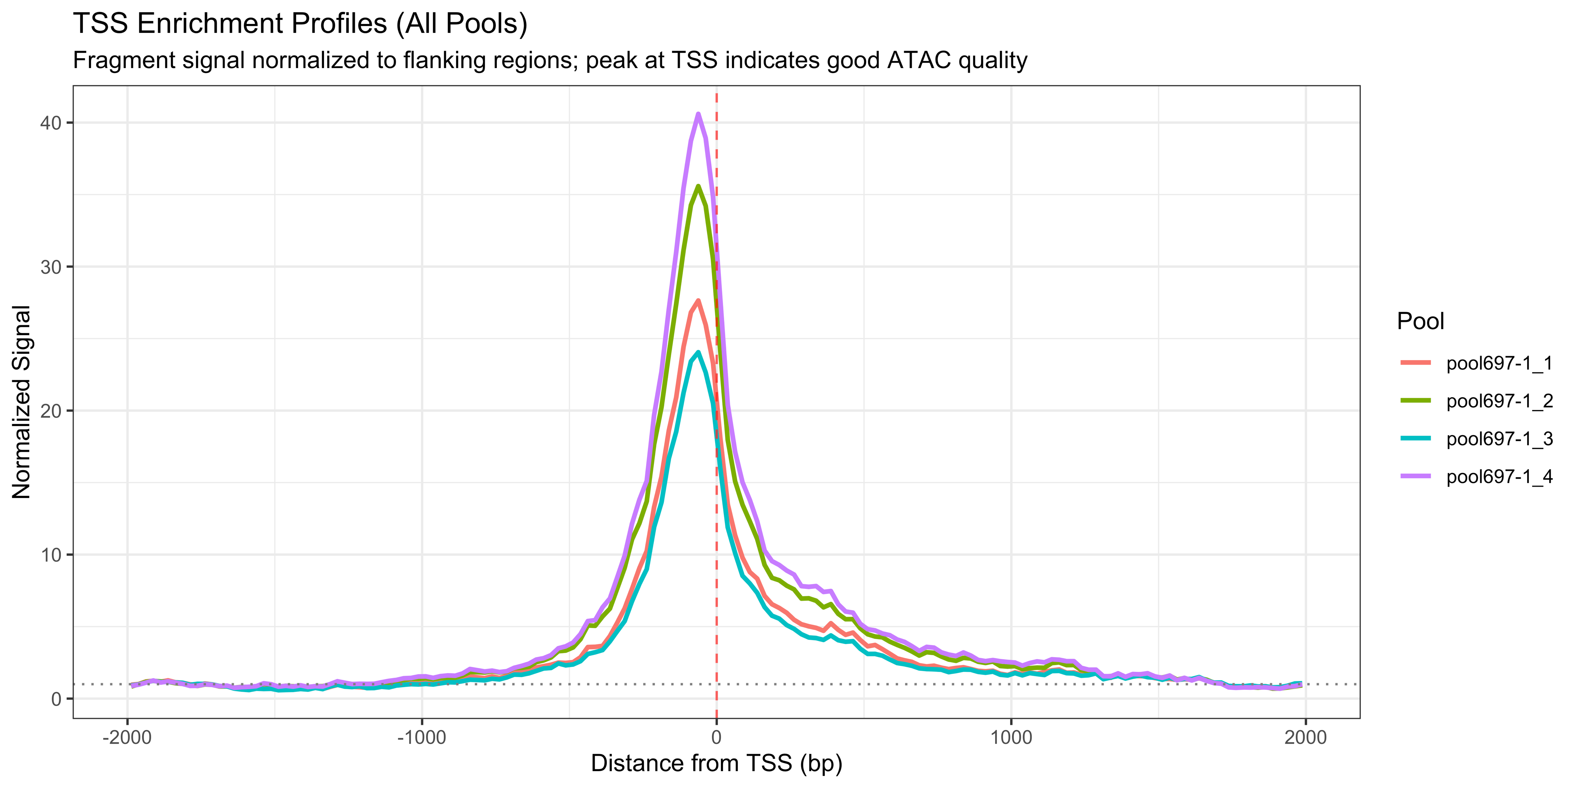
Atac: TSS enrichment profiles
Profiles look good/consistent; peak is upstream

Slide 14
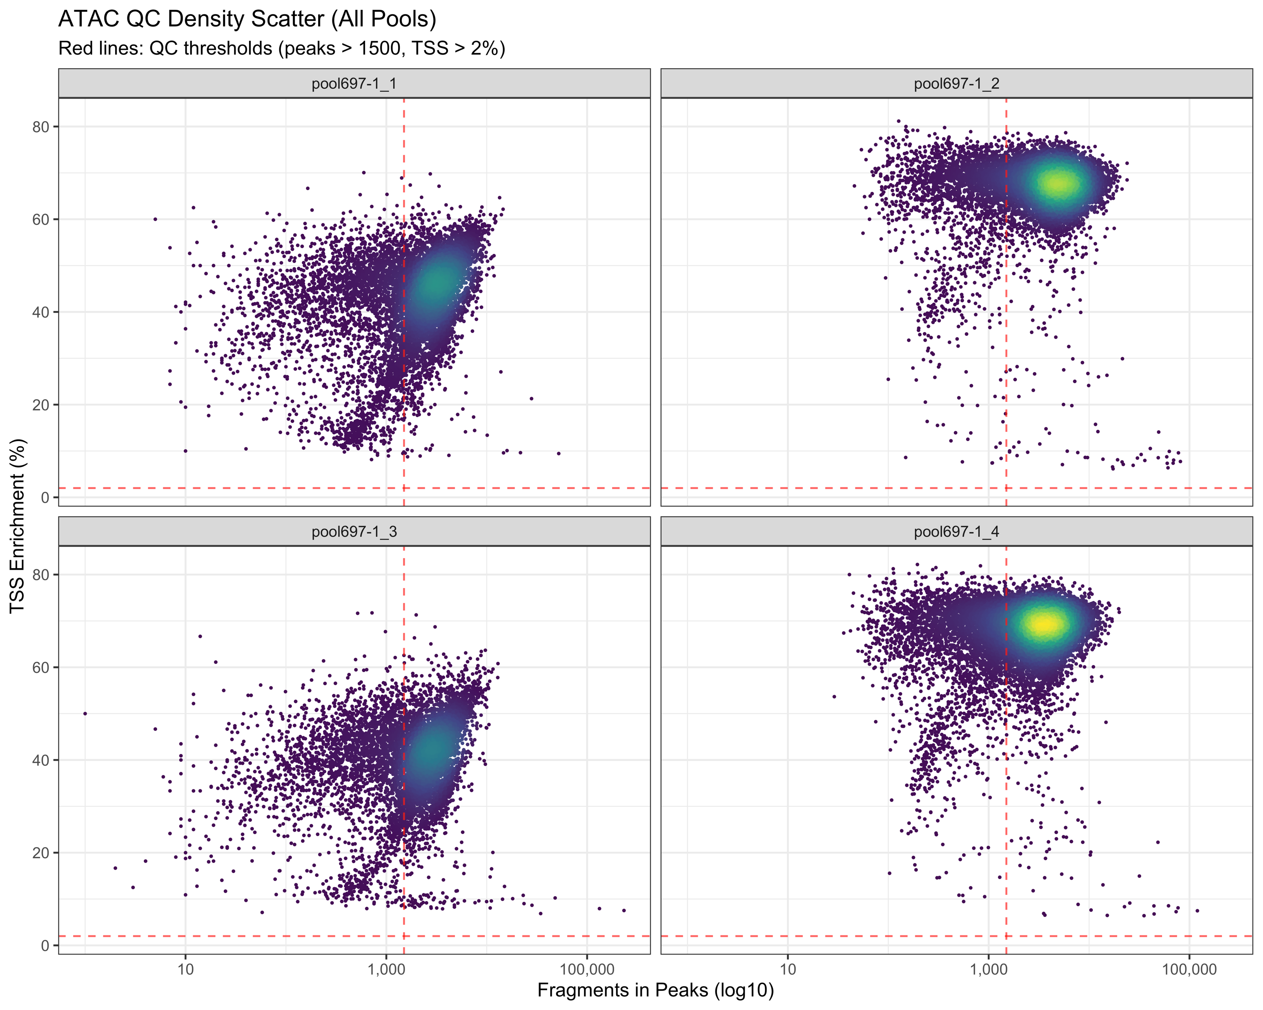
Atac tss enrichment vs fragments/peak
Overall good—we’ll keep an eye on pools 1 and 3

Slide 15
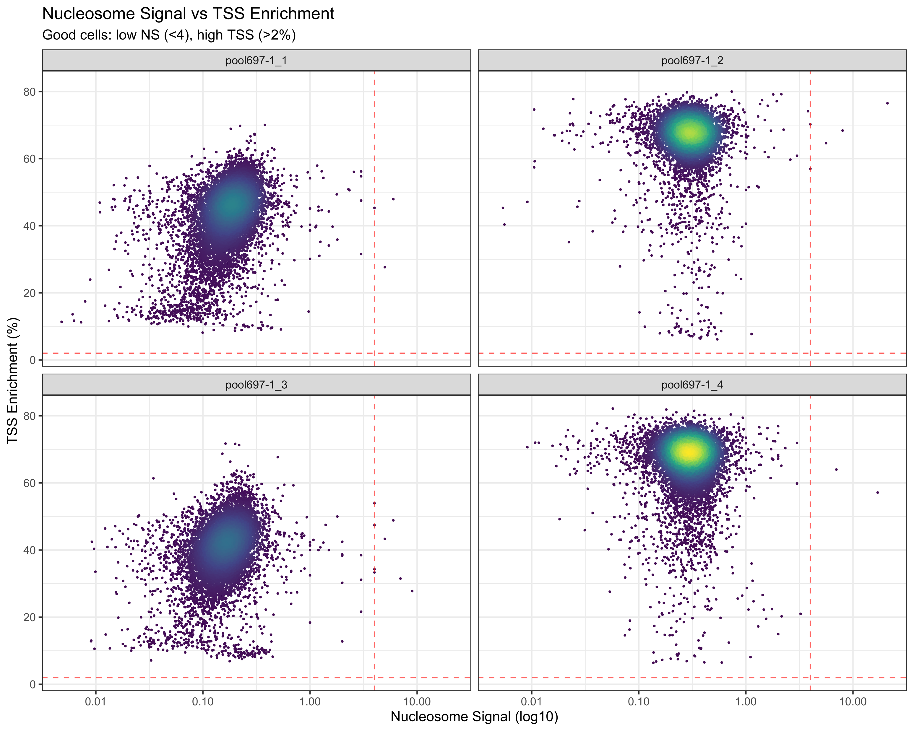
Tss enrichment vs nucleosome signal
Overall good—we’ll keep an eye on pools 1 and 3

Slide 16
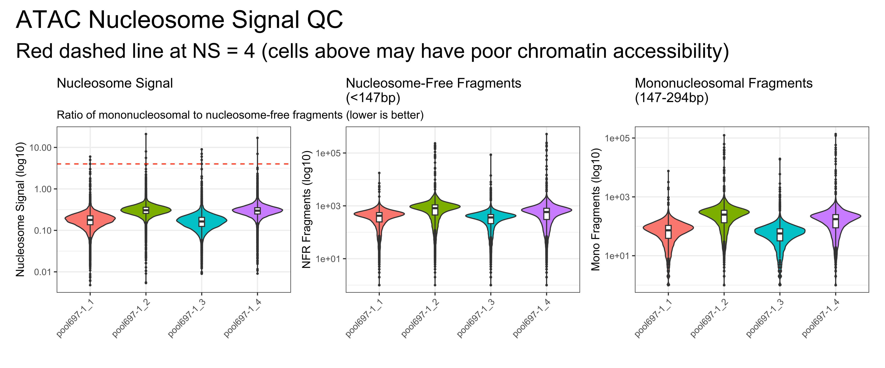
Nucleosome signal, nfr fragments, and mono fragments
Again, looks good, pools 1 and 3 are a little lower

Slide 17
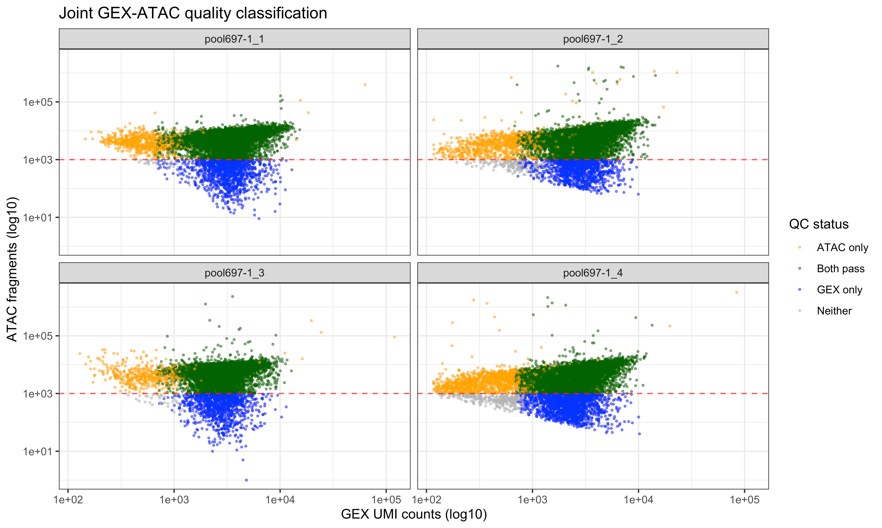
Combined gex-atac qc summary
jointQC | n | pct
ATAC only | 3514 | 6.6
Both pass | 43712 | 82.3
GEX only | 5258 | 9.9
Neither | 602 | 1.1

